Slide 1
Software BOM Management Version 2.0
Siva Jasthi
Community Faculty
Department of Computer Science and Cybersecurity
--
Siva.Jasthi@metrostate.edu Software BOM Management ICS 499 Summer 2022

Slide 2
GitHub Repo:
GitHub Repo: www.github.com/sjasthi/sbom2
Siva.Jasthi@metrostate.edu Software BOM Management ICS 499 Summer 2022

Slide 3
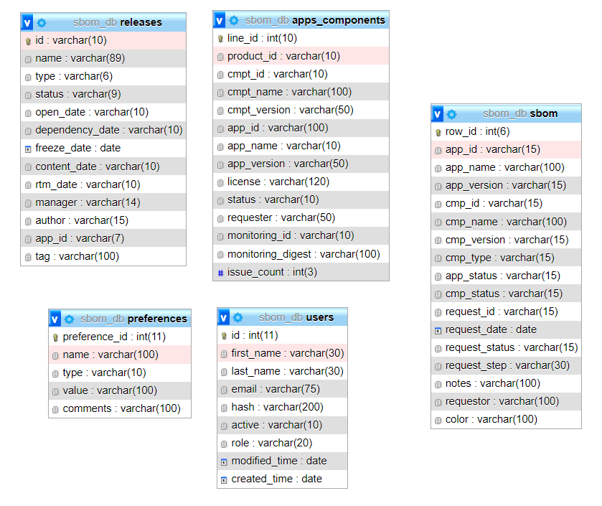
Database Schema
SBOM (in V1.0) will be replaced by apps_components table (in V2.0)
In V1.0, all the BOMs must be imported in one go.
In V2.0, BOM import is cumulative. Admins can import one BOM at a time.
Siva.Jasthi@metrostate.edu Software BOM Management ICS 499 Summer 2022

Slide 4
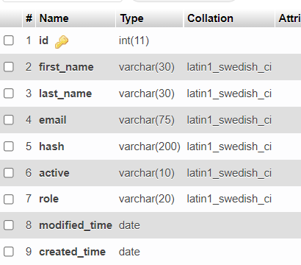
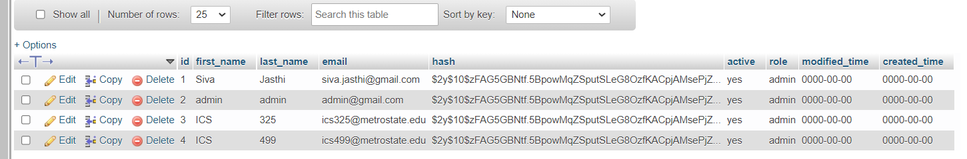
Users table
You can login as admin with any of the following user IDs
Password: 12345
Siva.Jasthi@metrostate.edu Software BOM Management ICS 499 Summer 2022

Slide 5
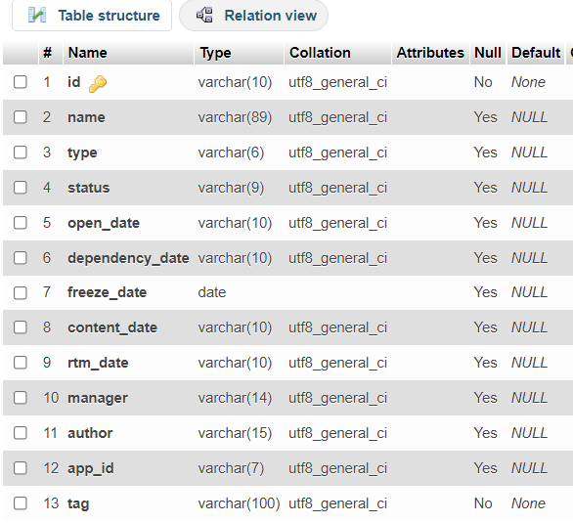
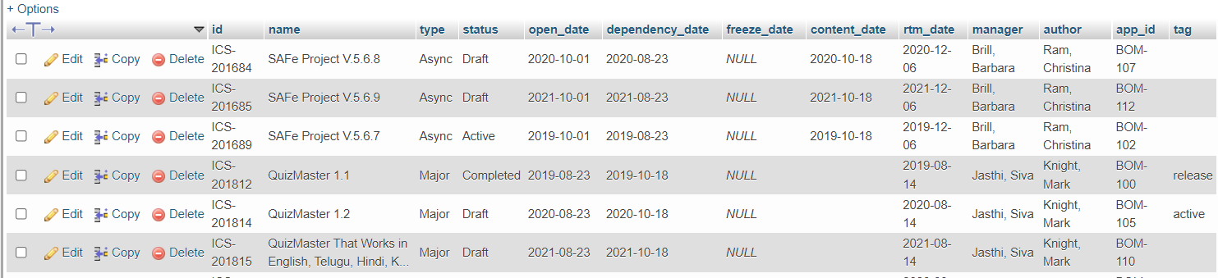
releases table
This table holds the “releases” and the meta data associated with each release
Siva.Jasthi@metrostate.edu Software BOM Management ICS 499 Summer 2022

Slide 6
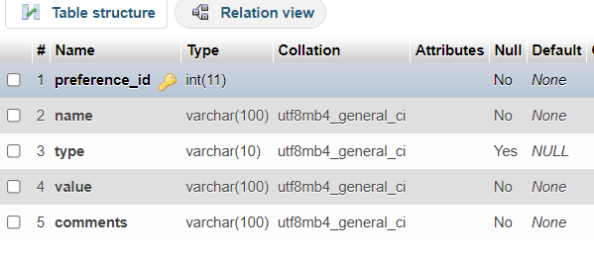
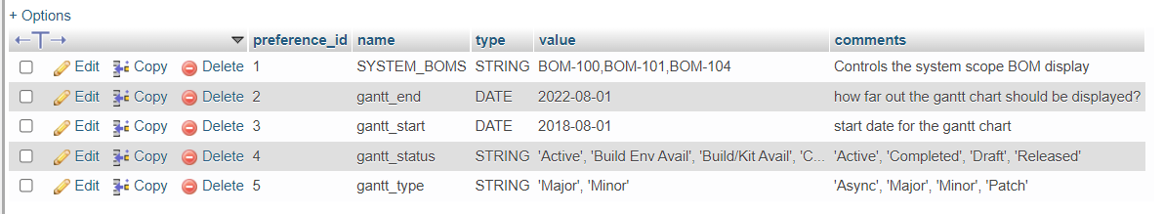
preferences table
We will hold the preferences in this table that drive the system behavior. For example, “SYSTEM_BOMS” drive the system behavior while displaying the BOM Tree or BOM List.
User preferences will not be saved in this table.
User preferences will be saved only in the COOKIES.
Siva.Jasthi@metrostate.edu Software BOM Management ICS 499 Summer 2022

Slide 7
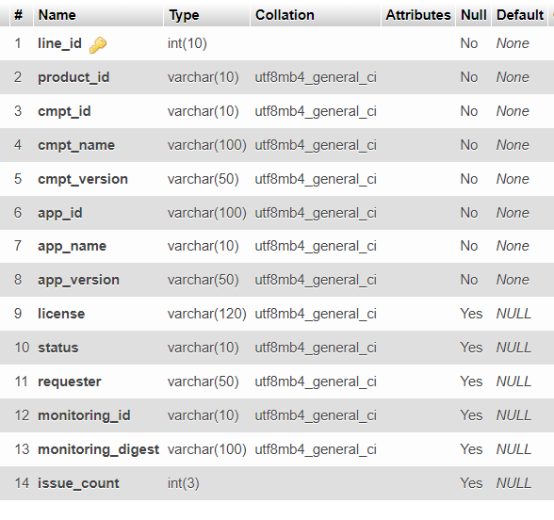
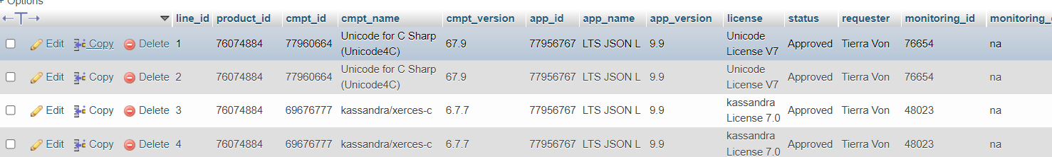
apps_components table
This is the primary table where the BOM data is maintained.
Admins can upload the BOMs into this table.
[1] BOM upload is cumulative. Only one BOM can be imported at a given time. (enhancement in V2.0).
[2] If the BOM (product_id) already exists in the table, then it is first removed from the table and the new BOM is imported into the table. (enhancement in V2.0).
[3] A one-time configuration (mapping) is required to map the CSV columns with the table columns.
Siva.Jasthi@metrostate.edu Software BOM Management ICS 499 Summer 2022

Slide 8
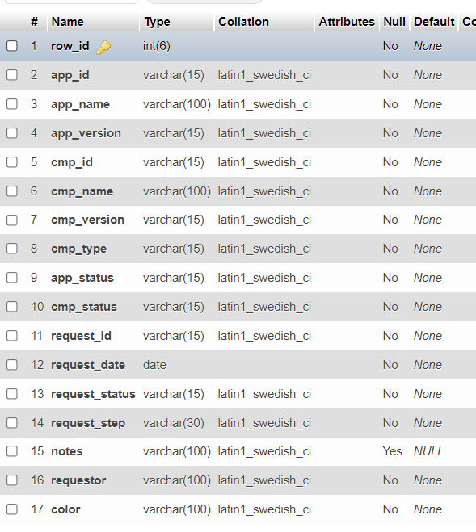
sbom table (earlier project)
do not use this.
Siva.Jasthi@metrostate.edu Software BOM Management ICS 499 Summer 2022

Slide 9
Requirements and Use Cases:
[1] Visualize the BOM as a flat list; Support filtering, sorting, searching, pagination, export (csv, excel, pdf) options using JQUERY Data table. Support filtering by the User BOMs, System BOMs, All BOMs.
[2] Visualize the BOM as a tree; Support filtering by the User BOMs, System BOMs, All BOMs. Support Color/No Color options.
[3] Enable admins to import the BOMs (one at a time). Support the mapping between a CSV file columns and the database columns
[4] Enable the admins to specify the system BOMs (a set of BOMs which are of interest to all users; Stored in the Preferences table; )
[5] Enable the admins to specify the user BOMs (a set of BOMs which are of interest to the users; Stored in COOKIE; Each user will see different visualization)
[6] Reporting (TBD): Support summary reports and visual dashboards based on the metadata of bom data.
Siva.Jasthi@metrostate.edu Software BOM Management ICS 499 Summer 2022

Slide 10
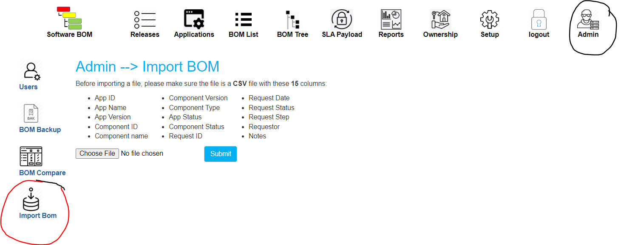
Importing a BOM
Only admins can login. See the users in “users” table. Use the password “12345” to login.
I added another “Import BOM” button to support the new schema
and to support “cumulative” BOM import. It points to the file “admin_import_bom_2.php”. This is the file you would be fixing/enhancing.
I left the V.1.0 “Import BOM” for reference purposes. It points to the file “admin_import_bom.php”
Siva.Jasthi@metrostate.edu Software BOM Management ICS 499 Summer 2022

Slide 11
Importing a BOM: Considerations
[1] Assume that the CSV file contains the data related to only one product_id.
We should take the “product_id” as input (in a text field during the import). Since a user may be uploading the same BOM repeatedly, you can save the ‘product_id’ as a COOKIE. The user can update the ‘product_id’ in the UI (and we will update the COOKIE accordingly).
[2] The CSV file may contain :
Not enough columns (This is an error. Report the error)
extra columns (Valid use case; Ignore the extra columns and handle the import)
Required columns in the wrong order (Valid use case; Handle the import)
Columns Names are different in CSV compared to what we have in the database (Valid Use Case; Empower the user to provide the mapping; Store the mapping information as a COOKIE; When the user imports another BOM, we rely on the ‘mapping’ cookie to do the import).
Create different test cases (CSV files) to test these scenarios.
[3] If the “product_id” already exists in the table, then all the data related to that BOM is removed first. And then the new data is imported. (We don’t want to compare what got changed; It is a brute force import).
Siva.Jasthi@metrostate.edu Software BOM Management ICS 499 Summer 2022

Slide 12
Success Criteria
ID | Requirement | Success Criteria | Points
1 |  |  | 25
2 |  |  | 25
3 |  |  | 25
4 |  |  | 25
5 |  |  | 25
6 |  |  | 25
7 |  |  | 25
8 |  |  | 25
9 |  |  | 25
10 |  |  | 25
Siva.Jasthi@metrostate.edu Software BOM Management ICS 499 Summer 2022

Slide 13
Questions
????
Siva.Jasthi@metrostate.edu Software BOM Management ICS 499 Summer 2022

